Slide 1
Introduction to Data Science Data Mining for Business Analytics
Brian d’Alessandro
Adjunct Professor, NYU
Fall 2015
Fine Print: these slides are, and always will be a work in progress. The material presented herein is original, inspired, or borrowed from others’ work. Where possible, attribution and acknowledgement will be made to content’s original source. Do not distribute, except for as needed as a pedagogical tool in the subject of Data Science.
Notes:
https://www.youtube.com/watch?v=aMDe5pODkB0 (harlan harris)

Slide 2
Evaluation metrics
Notes:
The goal of finding structure is to information from one source to reduce uncertainty about another source.
What does this mean? Conditional distribution example. I.e., carnival guy who guesses your weight. If I can see your height I can reduce uncertainty about weight.
Find some height/weight data.
Under supervised exploration:
How can we (automatically) obtain a selection of the more informative variables with respect to predicting the value of the target variable?
Even better, can we obtain the ranking of the variables?
Can think of importance as one that makes the target variable more pure. This leads to the notion of entropy.

Slide 3
Reminder
You will never build the perfect model… but we can always have a best model.
So far we have discussed the following design options:
[ Algorithm, Feature Set , Hyper-parameters (complexity)]
We also need to choose an evaluation metric!

Slide 4
The right metric depends on your goals
Ranking - Who are the top k prospects for my campaign, or what 10 items should I recommend?
Classification – Is this email spam or not? Is this number a ‘1’ or a ‘7’?
Density Estimation – What is the probability that this transaction is fraud? What is the expected spend of a new credit card customer?

Slide 5
Metrics for these Goals
Ranking
Area under the Receiver Operator Curve (AUC)
Area under the Cumulative Lift Curve (ACLC)
Classification
Lift (LFT)
Accuracy (ACC)
F-Score (FSC)
Precision (PRE)
Recall (RCL)
Density Estimation
Mean Absolute Error (MAE)
Mean Squared Error (MSE)
Cross-Entropy /Log-Likelihood (LL)

Slide 6

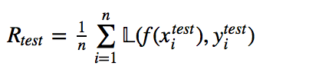
Train vs. Val/test loss
We don’t need to use the same error/loss/risk function on our training data as we do our validation or test data.
Training Loss
Usually used because they are well posed and “easy” to actually optimize (i.e., quadratic and smooth).
Logistic Loss, Hinge Loss, Least Squares etc.
Testing Loss
Often the most suitable loss function is not quadratic or too complex to train efficiently.
Precision, AUC, Recall.
vs.

Slide 7

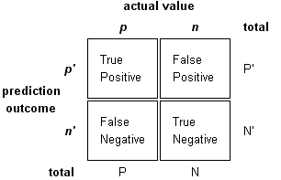
Confusion Matrix
Many of the metrics we use derive from the confusion matrix. For binary classification we assume there exists some real valued function f(x) and a decision threshold δ.
Higher
Model Prediction
Threshold
Lower

Slide 8
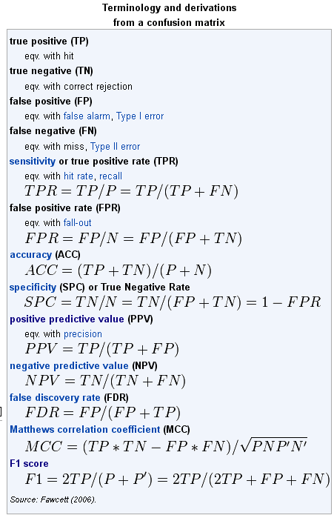
Classification Metrics
We can derive many classification metrics from the confusion matrix.
Source: http://en.wikipedia.org/wiki/Receiver_operating_characteristic#Area_under_curve

Slide 9
Some exposition
Precision - of all the instances I predict are positive, how many actually are positive? Lift is the precision normalized by the base rate (P(Y)).
Recall- how many of the total positives out there did I classify as positive?

Slide 10
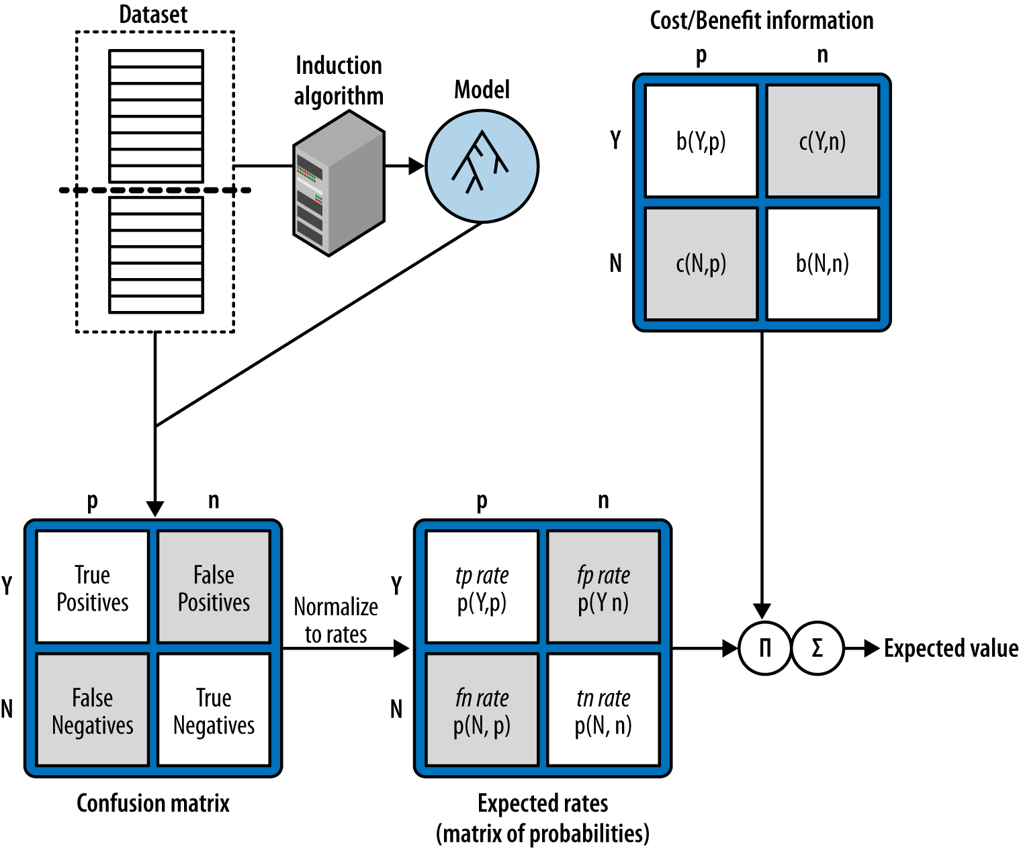
Designing A decision process
Training
Test/Use

Slide 11
Towards A Ranking Metric
Classification metrics depend on choosing a single threshold. But what if you don’t know or need the threshold?
Higher
Higher
Higher
Higher
Threshold 1
Model Prediction
Threshold 2
Threshold 3
Threshold 4
Lower
Lower
Lower
Lower
For each threshold we will get different accuracy, lift, precision and recall.
We want an evaluation method that considers the trade-off on these metrics when using different thresholds.

Slide 12
The Thresholding Trade-Off
Each threshold we choose creates a trade-off between false positive rate and true positive rate.
Threshold 4
Threshold 3
True Positive Rate: TP/(TP+FN)
Threshold 2
Threshold 1
False Positive Rate: FP/(FP+TN)

Slide 13
The ROC Curve
If we consider every threshold and plot the trade-off, we arrive at the ROC curve.
Threshold 4
Threshold 3
True Positive Rate: TP/(TP+FN)
Threshold 2
Threshold 1
False Positive Rate: FP/(FP+TN)

Slide 14
The Area Under the ROC Curve
The area under this curve gives a comprehensive summary of how well your classifier ranks.
True Positive Rate: TP/(TP+FN)
False Positive Rate: FP/(FP+TN)

Slide 15
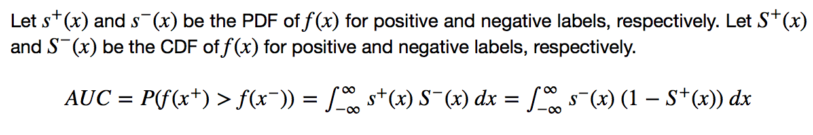
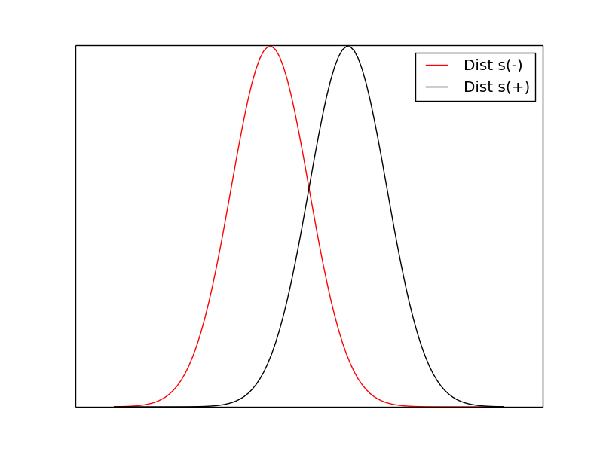
Probabilistic interpretation of AUC

Slide 16
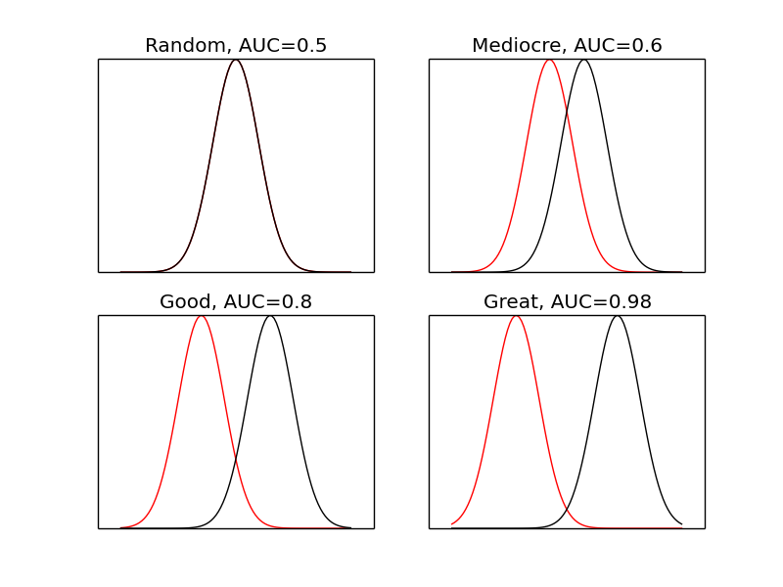
Different examples
A good AUC depends on the problem. Although AUC=0.6 means reasonably bad separation of the classes, it could still create value. Also, really high AUCs are often too good to be true and should be treated with suspicion.

Slide 17
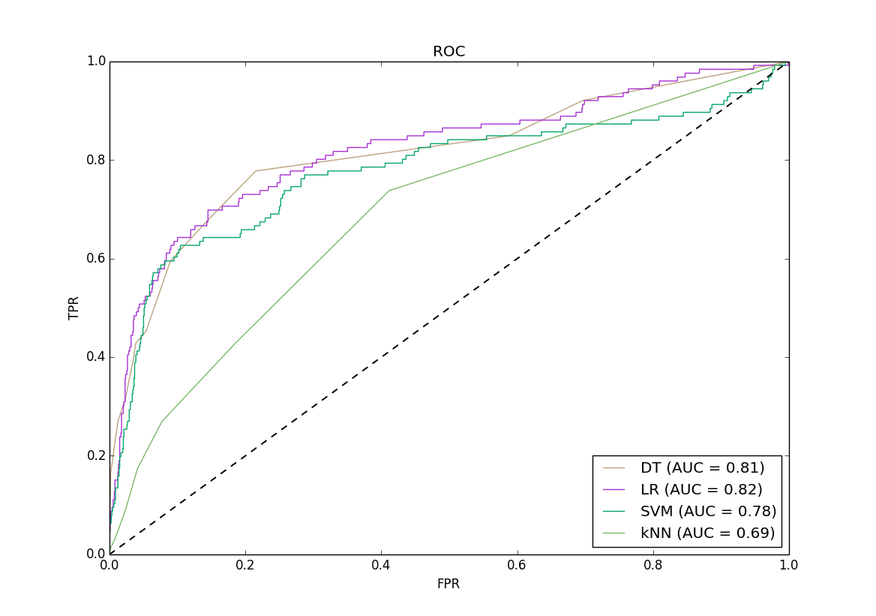
Comparing aucs
We built 4 different classifiers using the ads dataset. We can compare the models using ROC analysis.
A universally better model has higher TPR at all FPR (LR > kNN)
Some models overlap. Better model depends on whether you value TPR or FPR more (DT is best where FPR<0.05)

Slide 18
Fun AUC Facts
Nice interpretation: gives the probability that a positive instance will have a higher score than a negative instance (equivalent to Mann-Whitney U statistic)
Base Rate Invariant: AUC is invariant to P(+) in the data set (unlike lift metrics). Useful for doing comparisons across data sets with different base rates. Or after down sampling.
Is Nicely Bounded: AUC scores range from [0,1], where 1 is a perfect classifier and 0 is a perfectly wrong classifier. A random classifier has an exact score of 0.5.

Slide 19
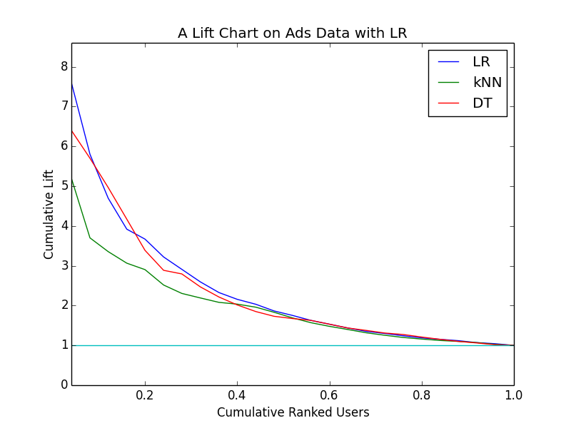
lift
Lift can be both a ranking metric and a classification metric. For ranking, we can see which model fits the entire distribution of users better. For single classification, we can measure lift for a desired targeting threshold.
Lift Properties
Nice interpretation: the lift tells you exactly how many more positive outcomes you might expect relative to the baseline strategy. Also lends well to economic analysis
Base Rate Non-Invariant: Lift will change if you alter P(+). This has implications for down sampling or for comparing models from different datasets.

Slide 20
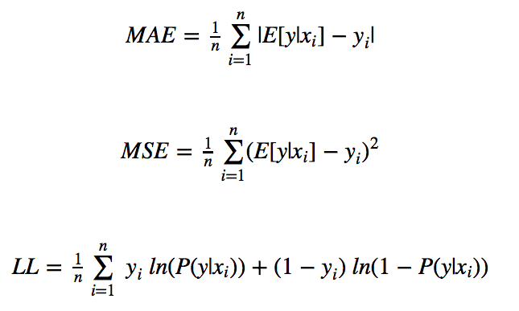
Density Estimation
Sometimes you want to evaluate how well your model estimates the underlying conditional distribution of your data: P(Y|X)

Slide 21
Back to ads data
Scenario 1:
Constraints: a budget k and a population n (k and n on the same unit scale)
Goal: Maximize the ROI for the client
Solution: Target (k/n)% of the population, such that the selected set of k prospects maximizes the total number of conversions
What metrics can we use to choose the best model

Slide 22
Back to ads data
Scenario 1:
Constraints: a budget k and a population n (k and n on the same unit scale)
Goal: Maximize the ROI for the client
Solution: Target (k/n)% of the population, such that the selected set of k prospects maximizes the total number of conversions
If we know k and n: Lift or Precision
If we don’t know k and n: AUC

Slide 23
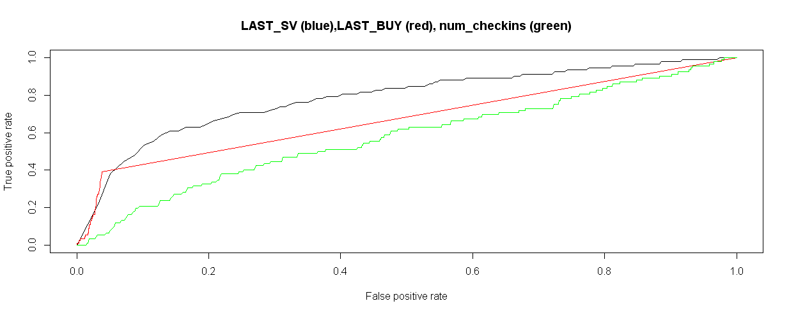
Roc curve of individual features
We can analyze the predictive power of individual features using AUC curves. Note the interesting shape of LAST_BUY AUC. What causes that?

Slide 24
Back to ads data
Scenario 2:
Constraints: each impression costs $C, for each conversion, receive $Q, unlimited budget
Goal: Maximize profit for the firm
Solution: Target every opportunity where
E[Value]= P(Conv|X)*$Q>$C
What metrics can we use to choose the best model

Slide 25


Back to ads data
Scenario 2:
Constraints: each impression costs $C, for each conversion, receive $Q, unlimited budget
Goal: Maximize profit for the firm
Solution: Target every opportunity where
E[Value]= P(Conv|X)*$Q>$C
To get a well calibrated estimate of P(Y|X), use

Slide 26
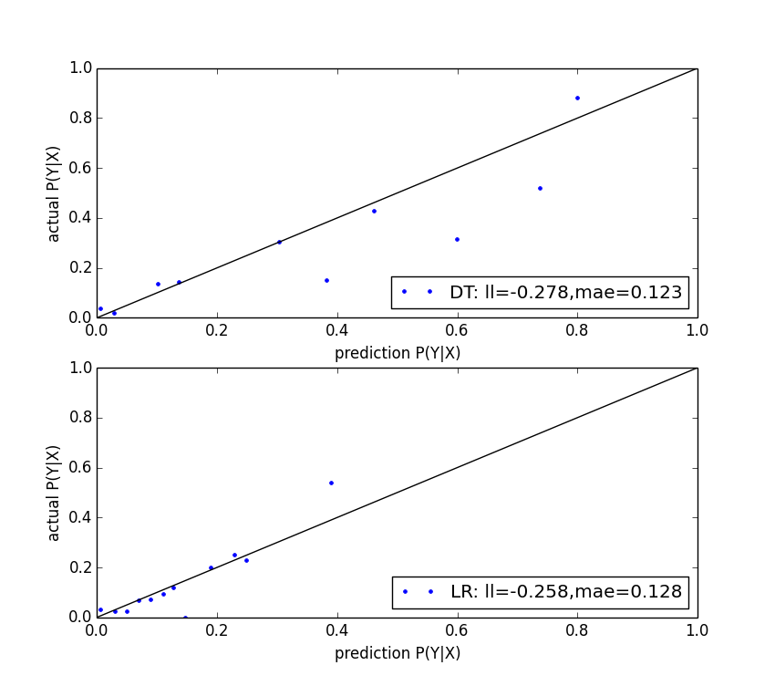
Calibration plots
We can generate calibration plots to visually inspect how well the predictions match the outcomes. To make the plot, we bin test instances by P(Y|X) and take mean(Y) against mean(P(Y|X)) for each bin.
Observations:
DT predicts a higher range of probabilities
LR is very well calibrated for lower valued predictions but not as good in the upper range.
Why is MAE lower for DT?

Slide 27
metrics don’t always agree
It is often the case that different metrics don’t agree (in terms of rank) when comparing models built with different design choices.
In this case we build univariate LR models on each feature and compare AUC, LL and Gini Index (from SK Learn Decision Tree)
Feature | AUC | -LL | Gini
visit_freq | 0.781 | 0.282 | 0.147
last_visit | 0.780 | 0.306 | 0.528
multiple_visit | 0.740 | 0.280 | 0.000
sv_interval | 0.717 | 0.323 | 0.046
buy_freq | 0.673 | 0.274 | 0.151
isbuyer | 0.670 | 0.278 | 0.000
last_buy | 0.665 | 0.321 | 0.015
buy_interval | 0.581 | 0.310 | 0.000
multiple_buy | 0.581 | 0.297 | 0.000
uniq_urls | 0.580 | 0.322 | 0.051
num_checkins | 0.567 | 0.326 | 0.062
expected_time_visit | 0.564 | 0.329 | 0.000
expected_time_buy | 0.518 | 0.327 | 0.000

